Slide 1
Marketing Predictive Analytics Using SAS
Team 3
Hemant Patil
Sanyogeeta Patil
Gauri Phansikar
Rohan Satam
Manish Vashistha

Slide 2
Market Overview
Coffee is one of the oldest and most popular beverages consumed all over the world
Market is very competitive for coffee
Local as well as global brands available
Market monopoly most common in coffee – Starbucks, Nestle, Folgers, Maxwell

Slide 3
Data overview
The data used is about the sale of coffee at drug and grocery stores
Based on the sales of coffee at these stores, the top 5 brands are Folgers, Maxwell House, Yuban, Chock Full O Nuts and Private Label
Selected brand of coffee – Chock Full O Nuts

Slide 4
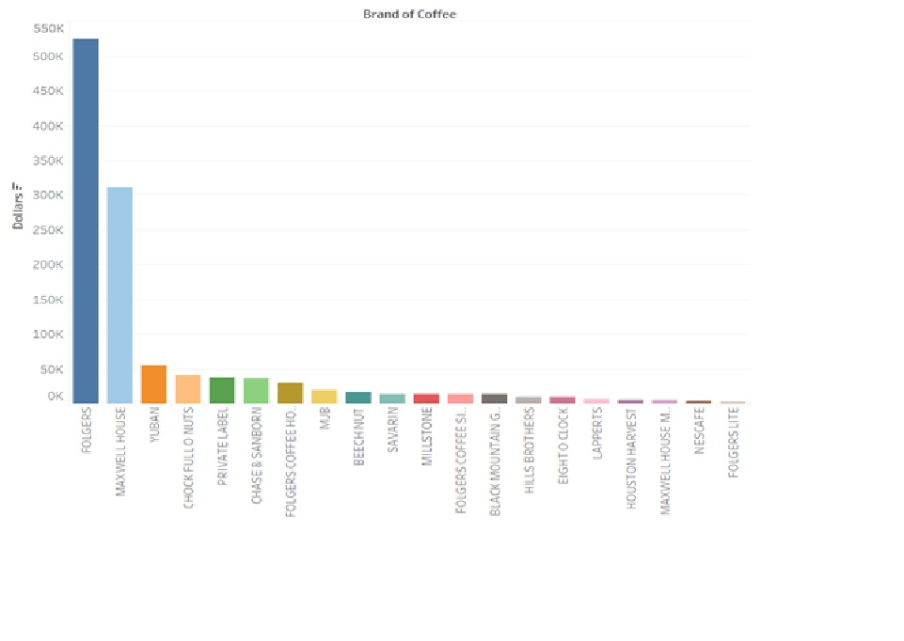
Top 10 Brands

Slide 5
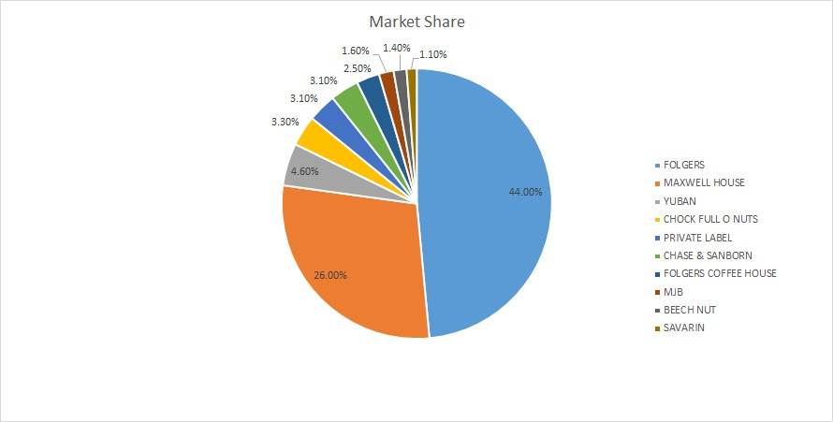
Market Share

Slide 6
Customer Segmentation & Targeting
Drug Store: -
Chock Full O' Nuts
People with income in the range 15k to 20k per year.
Number of TVs and Pets??
People with income in the range 55k to 65k per year
Number of TVs and Pets??
People with income in the range 45k to 55k per year
Number of TVs and Pets??
Which Segments to target??

Slide 7
Customer Segmentation & Targeting
Grocery Store: -
Chock Full O' Nuts
People with income in the range 25k to 35k per year.
Males are 65+ in age
2 or 1 member family
People with income in the range 35k to 45k per year
Males are 45 to 55 year old
2 member family
People with income in the range 35k to 45k per year
Males are 55+ in age
2 or 3 member family
Which Segments to target??
Notes:
All of them are full time workers.

Slide 8
Price Elasticity
One dollar increase in unit price causes a decrease in demand by 1.47%
Nearest competitor – Private Label
One dollar increase in unit price of Private Label brand increases the demand of chock full o nuts by 0.12%

Slide 9
Market Strategy
Units sold increases if the product has a larger size ad rather than a promotion
Minor display helps sell more units than a major display
Investing more in drug stores in Hartford and in grocery stores in Syracuse is advisable against any other cities
The market for coffee is highly price sensitive

Slide 10
Key take away
Target retired people with income in the range 25k to 45k per year for drug store and Full time workers with income in the range 35k to 55k per year
People choose Private Label as an alternative to chock full o nuts
Having a large size ad and a minor display helps selling more units

Slide 11
Thank You

